Slide 1

Wired LANs: Ethernet
Wireless LANs
Wireless WANs: Cellular Telephone and Satellite Network
AKTU, LUCKNOWCENTER OF ADVANCE STUDIES
BY-Kumar Shanu Singh
Nitesh Kumar

Slide 2
Local Area Networks
Local area networks (LANs) connect computers within a building or a enterprise network
Almost all LANs are broadcast networks
Typical topologies of LANs are bus or ring or star
We will work with Ethernet LANs.

Slide 3
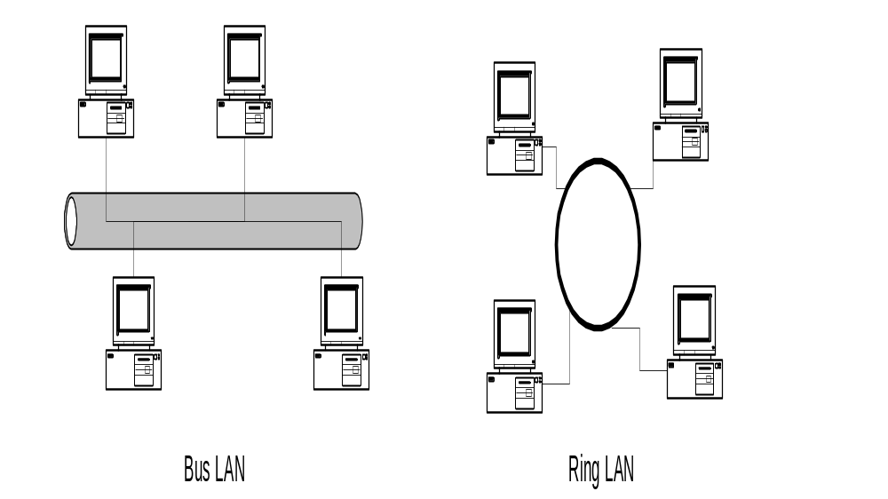

Slide 4
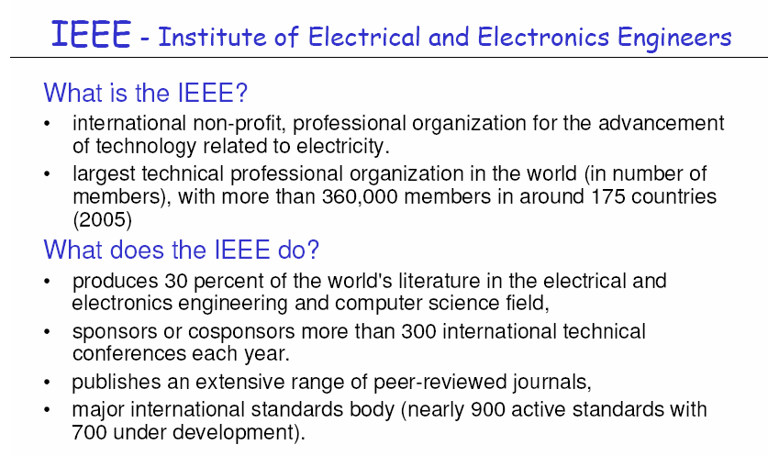

Slide 5
IEEE 802 Standards
IEEE 802 is a family of standards
for LANs, which defines an
LLC and several MAC sub layers

Slide 6
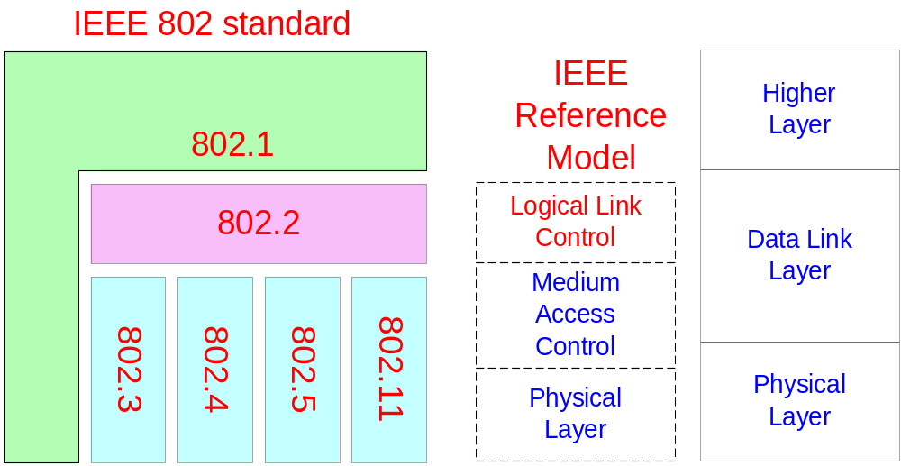

Slide 7
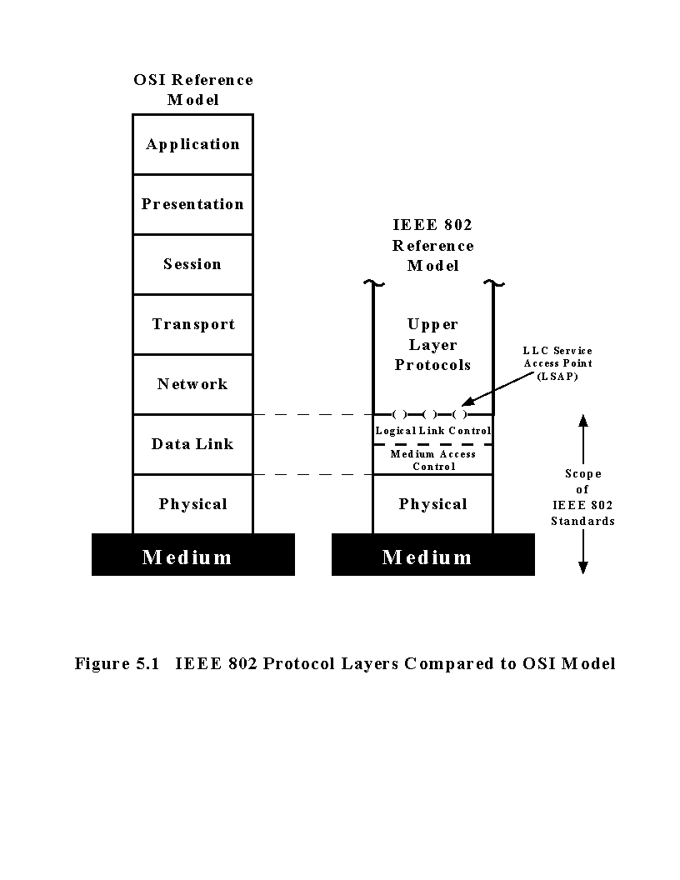
IEEE 802 LAN Layers

Slide 8
IEEE 802.3 Ethernet LANs
  The MAC layer uses CSMA/CD (Carrier Sense Multiple Access with Collision Detection) technology.
    When a computer wants to transmit a frame it:
      Listens for a frame on the cable, if busy, the computer waits for a random time and attempts transmission again. This is known as Carrier Sense.
      If the cable is quiet, the computer begins to transmit.
      Two computers could transmit at the same time. To prevent this happening, the transmitting computer listens to what it is sending.
      If what it hears is different to what it is sending, then a collision has occurred. This is known as Collision Detection.

Slide 9
Contd……..
  When a computer wants to receive a frame it:
    Listens to all frames traveling on the cable.
    If the frame address is the same as the computer’s address or the same as the group address of the computers of which it is a member, it copies the frame from the cable.
    Otherwise it just ignores the frame.
    Note: Ethernet LAN is a broadcast network. It is possible to
      Unicast a frame from one computer to any other computer connected to the same cable.
      Broadcast a frame from one computer to all other computers connected to the same cable.
      Multicast a frame from one computer to a subset of the computers connected to the same cable.

Slide 10
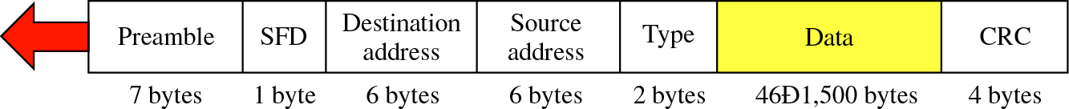
Carrier Sense Multiple Access with Collision Detection (CSMA/CD)
The basic idea:
When a station has a frame to transmit:
1) Listen for Data Transmission on Cable (Carrier Sense)
2) When Medium is Quiet (no other station transmitting):
  a) Transmit Frame, Listening for Collision
  b) If collision is heard, stop transmitting, wait random time, and transmit again.
Frame format
This portion must be at least 64 bytes for the Ethernet to work correctly

Slide 11
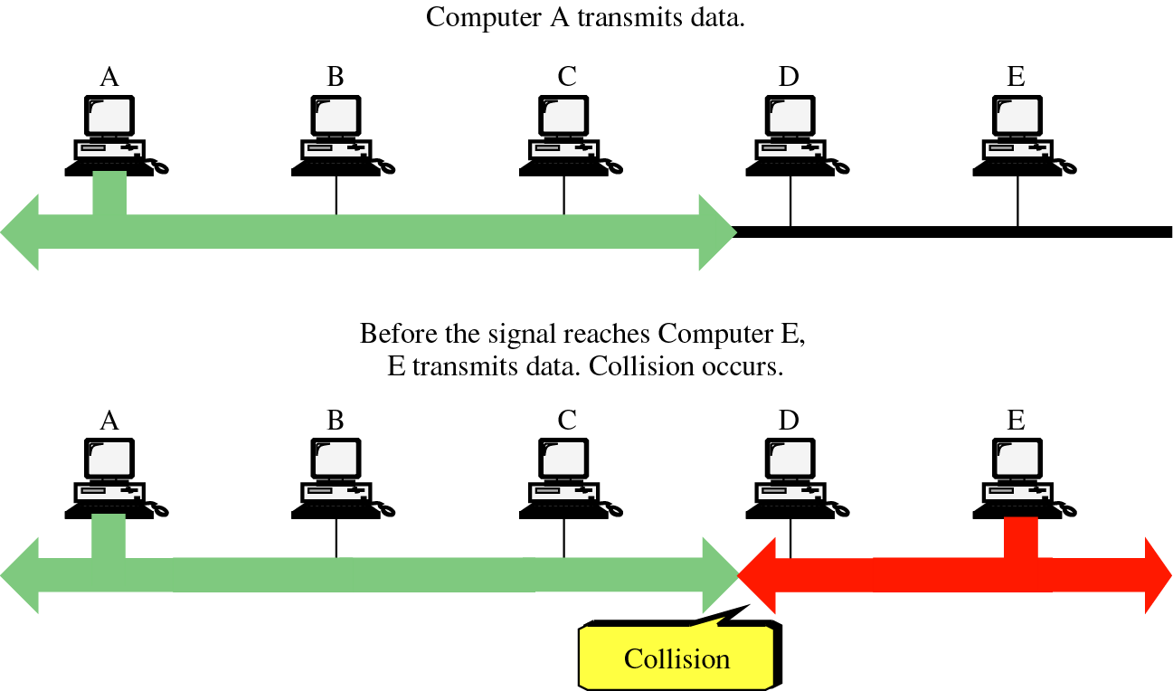

Slide 12
IEEE 802.3 Cabling Standards
  The following is a list of the commonly used cables in 802.3 LANs.
Cable Name | Cable Type | Transmission Rate | Max. length before repeater needed | Max. No. of Computer
10Base5 | Thick coaxial | 10Mbsec | 500 metres | 100 per segment
10Base2 | Thin coaxial cable | 10Mbsec | 200 metres | 30 per segment
10BaseT | Twisted Pair | 10/100 Mbsec | 100 metres | 1024 per segment
10BaseF | Fiber Optic cable | 100/1000 Mbsec | 2000 metres | 1024 per segment

Slide 13
IEEE 802.3 Cabling Standards
  10Base5
  Bus topology is used.
    Connections are made using tap to a thick coaxial cable.
    This results in a poor connection between the computer and the coaxial cable.
  10Base2
    This was the most popular 802.3 cable because it was cheap and there was a good connection between the computer and the coaxial cable.

Slide 14
  10BaseT
  star topology is used.
  Stations are connected to a hub via two pairs of twisted cable.
    Currently most popular since it is easy to maintain but is more expensive.
  10BaseF
    Good for high speed connections between buildings.

Slide 15
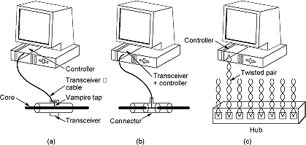
10Base5
10Base2
10BaseT

Slide 16
Types of Ethernet
1) FAST ETHERNET
2)GIGABIT ETHERNET
-1 Gigabit
-10 Gigabit

Slide 17
802.5 Token Ring LANs
  A Token Ring LAN consists of a collection of ring interfaces connected by point-to-point lines.
Ring interface
Unidirectional
Ring – One Way
Computers

Slide 18
IEEE 802.5 Token Ring LANs
  The MAC sub layer uses Token Ring Technology.
  In a Token Ring LAN, a special bit pattern called the token circulates around the ring whenever all computers are idle.

Slide 19
  When a computer wants to transmit:
    It waits for the token to arrive.
    When it arrives, it removes the token from the ring. There is only one token so only one computer can transmit at any one time.
    The computer can now transmit its frame on its output link.
    This frame will now propagate around the ring until it arrives back at the sender who removes the frame from the ring.
    The sender then regenerates the token and passes it to the next computer (restarting the above steps).

Slide 20
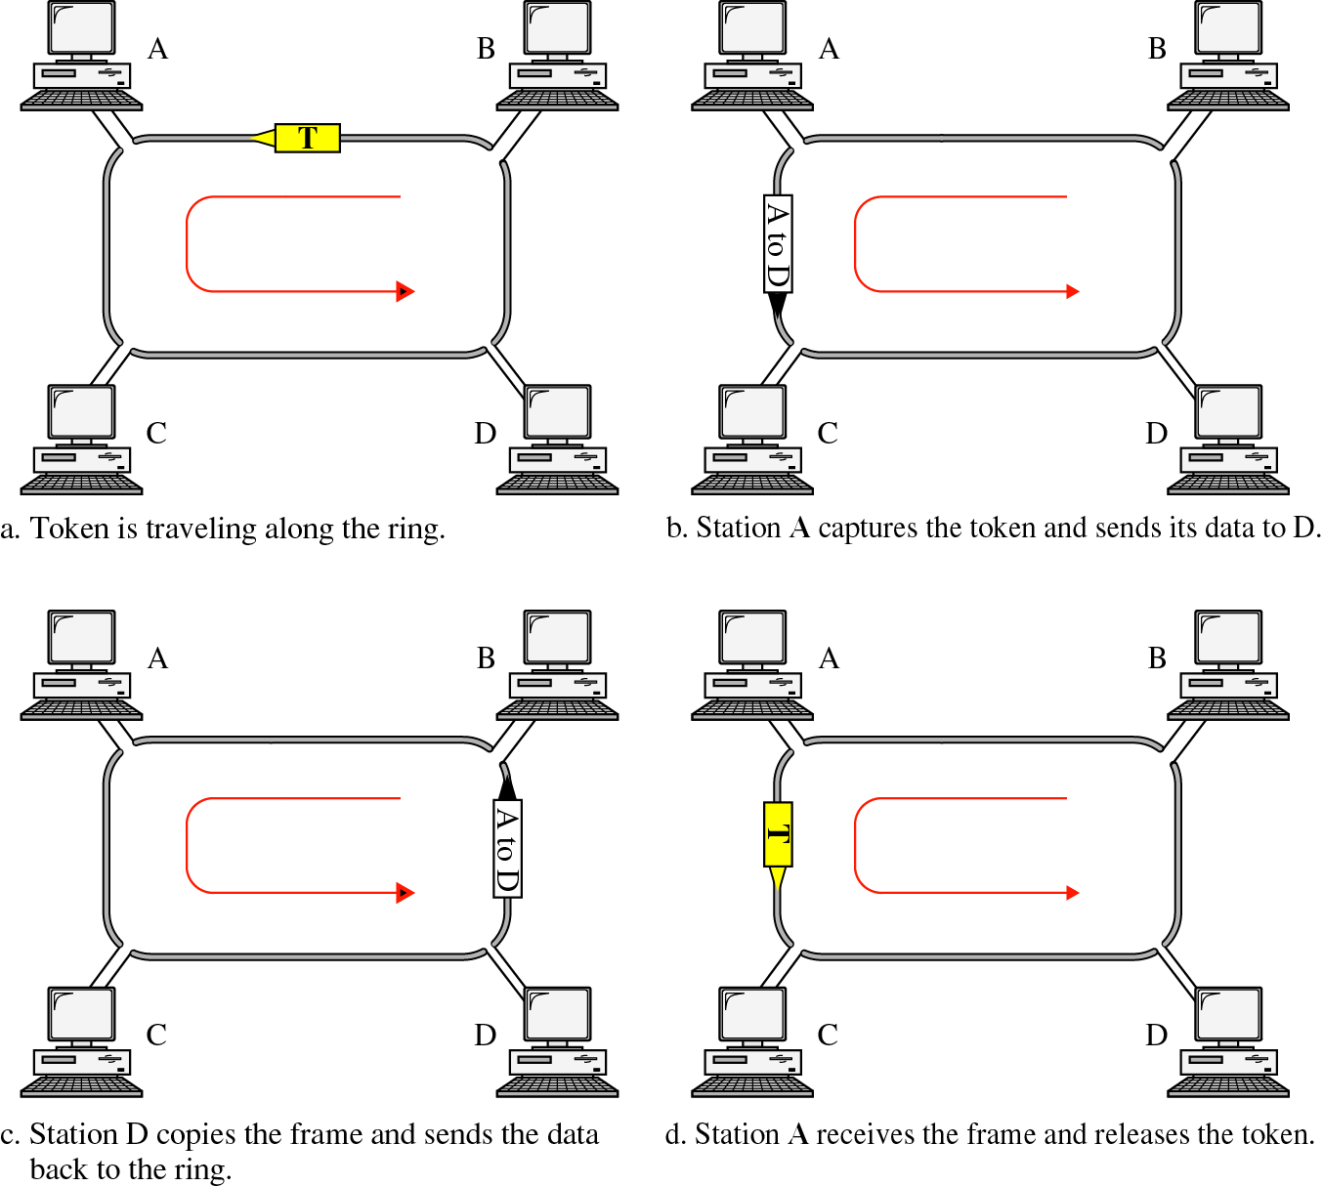

Slide 21
IEEE 802.5 Frame Format
Bytes 3 2 or 6 2 or 6 4 1 1
Start of
Frame
Delimiter
Destination
Address
Source
Address
Data – No Limit
Checksum
Same as
802.3
End
Delimiter
Frame
Status
Difference between Start of Frame and Token is only 1 bit in 3rd byte.
Token
3 Bytes
  Start of Frame and End Delimiters mark the beginning and ending of a frame.
  Destination Address, Source Address and Checksum are used in a similar fashion to IEEE 802.3 Ethernet.

Slide 22
Comparison of 802.3 ‘Ethernet’ and 802.5 ‘Token Ring’
  Generally they have similar technology with similar performance.
  802.3 Ethernet – Advantages
    Widely used at present. People are experienced in using this technology.
    Simple Protocol. New computers can be added with having to bring the network down.
    Almost zero delay at low load, there is no need to wait for a token, you can transmit when ready.

Slide 23
  802.3 Ethernet – Disadvantages
    The electronics is more complicated for carrier sense and collision detection.
    The smallest frame must hold 64 bytes, this means there is a substantial overhead if you are only transmitting a single character from your machine.
    Ethernet is non-deterministic system (possibility of repeated collisions). This means that Ethernet is not suitable for network applications that require guaranteed delivery times.
    Poor performance at high loads as there can be lots of collisions reducing the number of messages that are successfully transmitted.

Slide 24
Comparison………..
  802.5 Token Ring – Advantages
    Token Ring uses point-to-point connections between ring interfaces so that the electronic hardware can be fully digital and simple. There is no need for collision detection.
    Can use any medium twisted pair is cheap and easy to install but could equally use fiber optic if available.
    Throughput excellent at high loads since there is no possibility of collisions unlike 802.3.

Slide 25
  802.5 Token Ring – Disadvantages
    Computers must wait for the token to arrive, therefore at load, a computer is delayed before sending.
    Each token ring has a monitor computer, to look after the ring. If the monitor computer failed, the remaining computers would have to wait until it is replaced before being able to continue.

